Slide 1
Phase II – Business Processes
Security Violation Notifier
Group C • Nshuro Arnaud Nelligan (27960)

Slide 2
Business Process Overview
Automated monitoring of suspicious user activities.
Detects privacy/security violations and alerts administrators in real time.
Replaces manual monitoring with an intelligent notification system.
Actors Involved
- System Administrator: Configures rules & handles alerts
- Security Officer: Investigates incidents
- End Users: Their activities are monitored
- Authentication Server
- Notification Service
- System Database

Slide 3
Triggers
- Unauthorized login attempt
- Accessing restricted resources
- Multiple failed logins
- Suspicious location/device login
- Data download spikes
- Tampering with security settings
Pre- & Post-Conditions
Pre-Conditions:
• User accounts & roles exist
• Monitoring rules configured
• Log sources connected
• Notification channels active
Post-Conditions:
• Alert delivered
• Violation logged
• Dashboard updated
• Investigation record stored

Slide 4
Core Business Process Flow
1. Monitor activities in real time
2. Log user actions
3. Analyze actions
4. If normal → store log
5. If violation → classify
6. Generate alert
7. Notify admin
8. Admin investigates
9. Close case
Business Rules
BR1: Authorization rule
BR2: Failed login thresholds
BR3: Anomaly detection
BR4: Data access restrictions
BR5: Critical alert notification
BR6: Audit logging

Slide 5
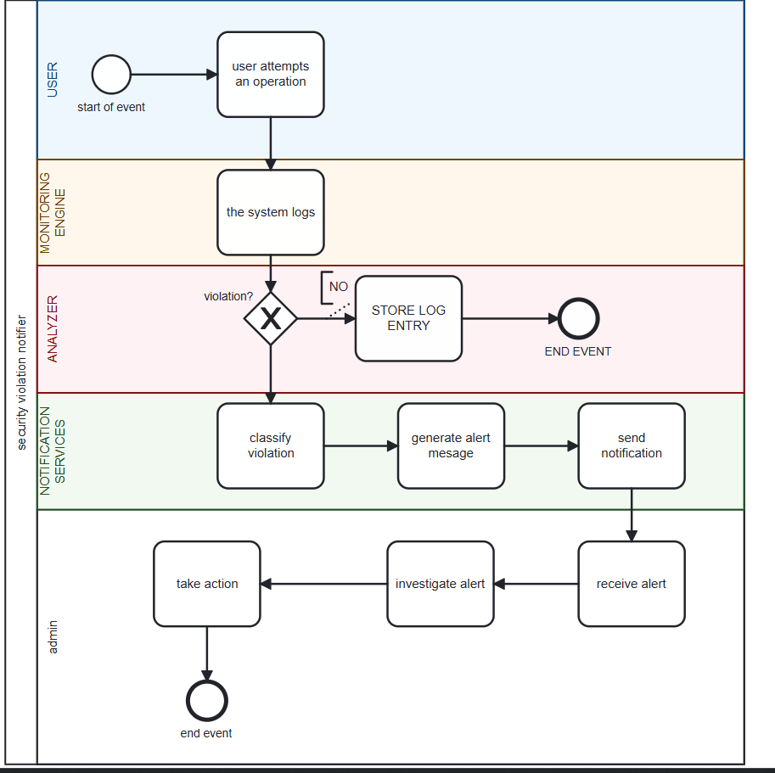
BPMN DIAGRAM

Slide 6
BPMN Summary
USER LANE: Perform Action, The user attempts an operation such as: login, open a file, access a restricted table, perform an update/delete
MONITORING ENGINE LANE: The system logs, user ID, timestamp, operation type, IP address/ device
ANALYZER LANE: Violation?, if no then normal log record, if yes the flow continues to notification service
NOTIFICATON SERVICE LANE: Classify Violation, in types: Unauthorized access, Multiple failed logins , Accessing restricted data, Malicious action attempt, Generate Alert Message, Creates a structured alert containing: Username, Time of event, Violation type, Severity level, Send Notification, seent via: Email, SMS, System dashboard pop-up
ADMINISTRATOR LANE: Receive alert, admin gets the violation notice, investigate incident, admin checks logs, user history, severity, possible threat level, take action, possible actions: look user, reset password, issue warning, escalate case, document solution

